Slide 1
Processing Geographical Data in QGIS
Session 1

Slide 2
What will you learn today?
Workflow to organise data (download and folder management)
How to merge datasets into one (raster and vector data)
Familiarise with topographical data and organise them for analysis
Geoprocessing tools
Understand how raster geoprocessing tools (subsetting geospatial data based on clips) work and how they can be used
Understand how vector geoprocessing tools (buffer, intersection, dissolve, difference) work and how they can be used
Visualisations
Simple ways to display geo processed data
Simple geospatial analysis
Count points in polygon
Zonal statistics

Slide 3
Workflow to organise datasets
Geo datasets are massive! Raw datasets are typically available in “chunks”.
E.g. Topographical data
What does it mean?
Let’s add what you have got in the folder to QGIS…how?
Are contouring data in the folder vector data/ raster data?

Slide 4
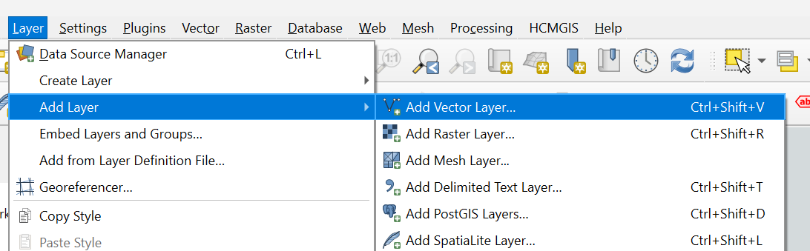
Workflow to organise datasets
To import vector layers, go to layer> add layer> add vector layer > add all the .shp files

Slide 5
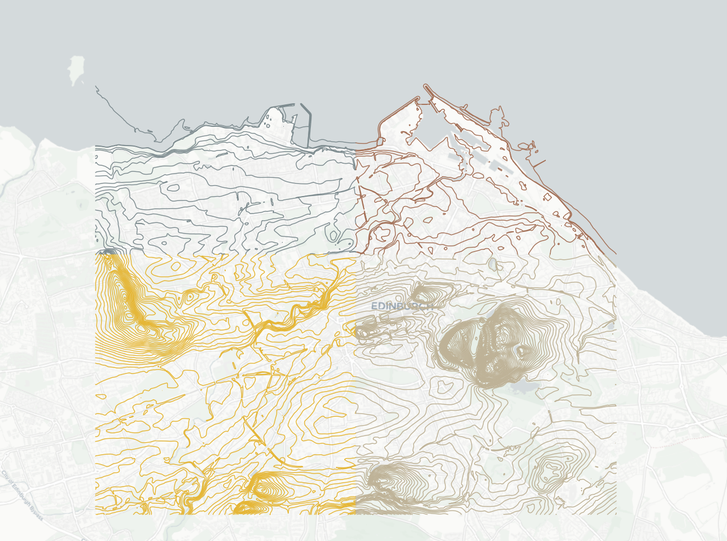
Workflow to organise datasets
You may have found that some vector data downloads as ‘tiles’
you want to merge them together to either:
Tidy up your layers so they are all one object with the same symbol
So that you can run a calculation on all of them
How?

Slide 6
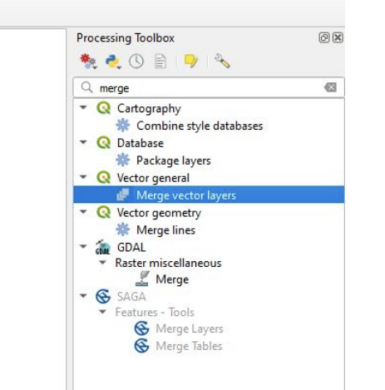
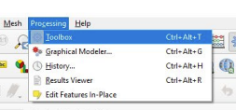
Merging Vector Data
Go to Processing > Toolbox
Find Merge vector layers (use the search bar to help).
Double-click the tool to launch it.

Slide 7
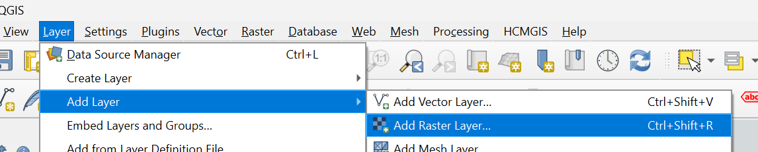
Merging Raster Data
Similarly, you might have raster downloads as ‘tiles’ and you want to merge them together to either:
Make the base appear as one continuous map.
Run a calculation on all of them at the same time.
Let’s import the raster data
Layer > Add Layer > Add Raster Layer> add all the .asc files

Slide 8
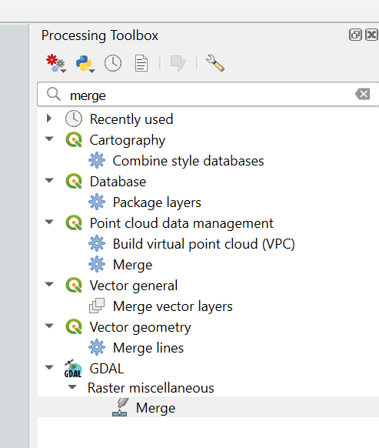
Merging Raster Data
Go to Processing > Toolbox
Find Merge under GDAL > Raster miscellaneous

Slide 9
Merging Raster Data
Input your layers.
Set the output data type to Int16.
Click “run”

Slide 10
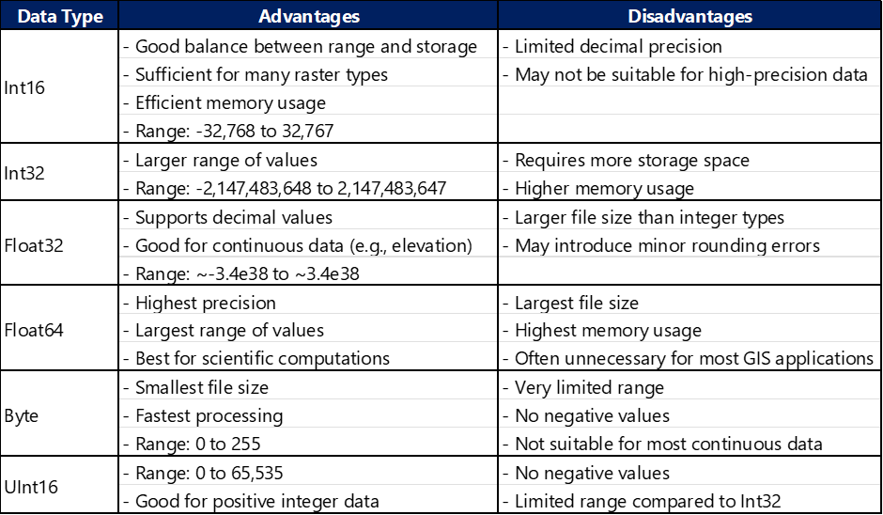
Comparison of different data type inputs

Slide 11
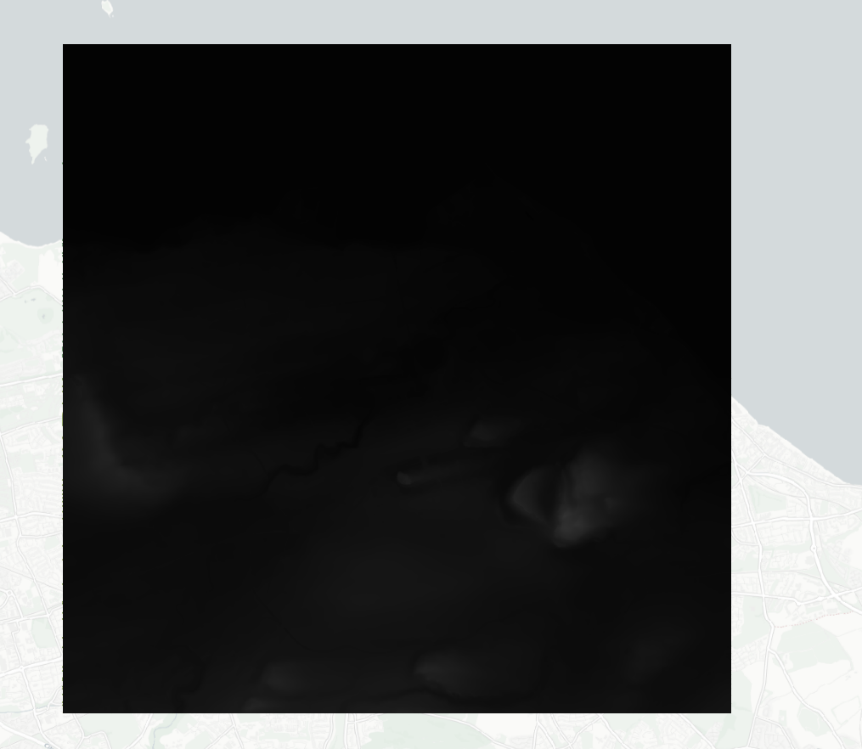
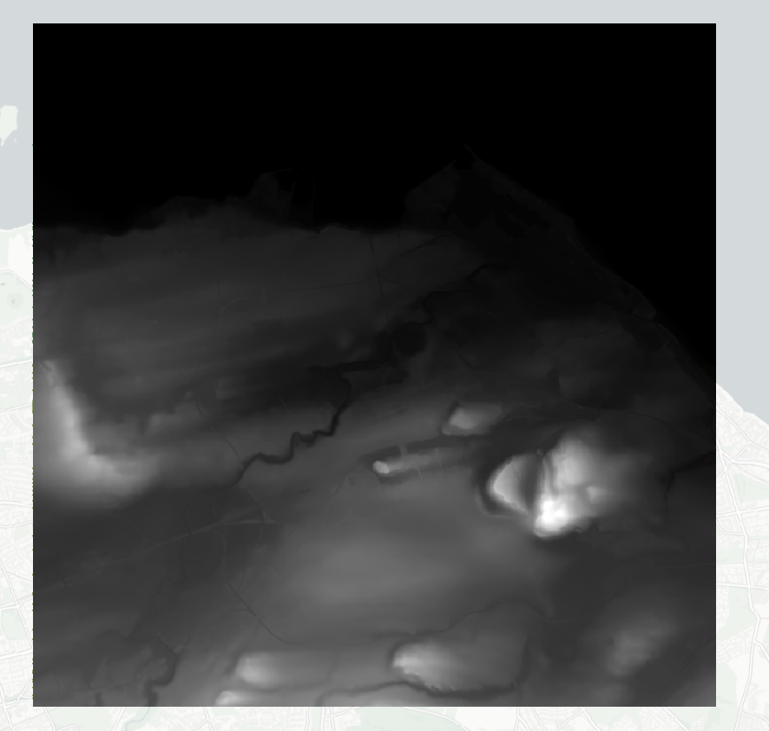
Merging Raster Data
Do you notice how the tiles differ before and after the merge?

Slide 12
Transforming Raster to Vector - When and How?
Please now overlay the merged vector contouring lines onto the merged raster file.
The merged vector files are based on contouring interval at 5m apart (OS Terrain 5).
However, sometimes, you have to work on an area where smaller contouring intervals might be needed (e.g. slope for traffic analysis/ travelling time estimation for walking)
In this case, vector contouring can be generated from raster.
* Always check if the file you need is downloadable first in survey websites to ensure legitimacy, accuracy and reliability.

Slide 13
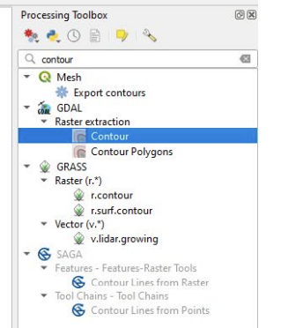
Transforming Raster to Vector - When and How?
Let’s say you want contouring interval at 1m instead.
Find the contour tool in the processing toolbox.
Select input layer
Interval between contouring lines = 1 (=1m)
Press “Run”

Slide 14
Geoprocessing
Geoprocessing is a GIS operation use to manipulate spatial data. A typical geoprocessing operation take an input dataset, performs an operation on that dataset, and returns the result of the operation as an output data set.
For example:
Taking the Listed Buildings dataset and using a clip tool to see how many of the Listed Buildings are within a Conservation Area.
Using the buffer tool to identify Local Nature Reserves which are within 1km of a settlement.
A wide range of tools can be explored in the Processing Toolbox.
We will look at the most commonly used ones.

Slide 15
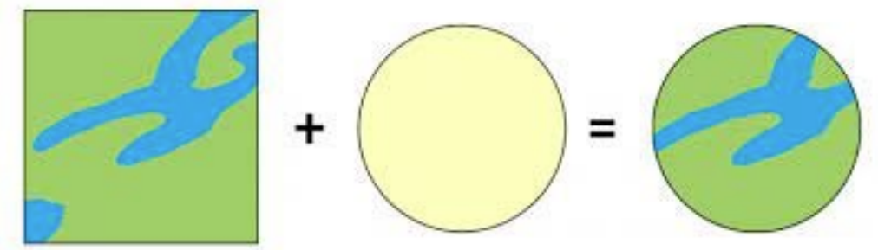
Geoprocessing - Clip
Clip essentially is a common tool to subset data.
However, clipping a vector is different from clipping a vector

Slide 16
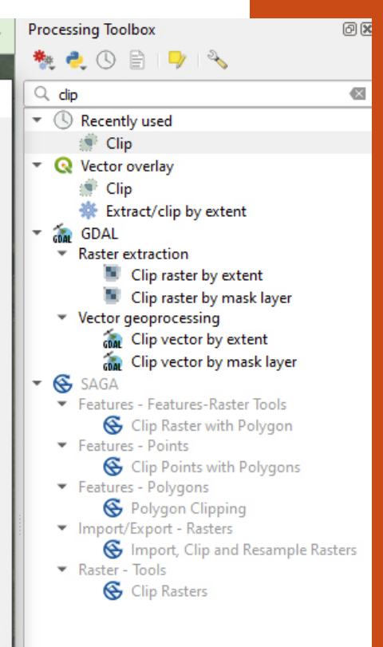
Geoprocessing - Clip
Open Processing Toolbox
For vectors: Clip under vector overlay Overlay the road vector with the Low Emission Zone vector layer
For rasters: Clip raster by mask layer Overlay noise raster layer with the Low Emission Zone vector layer

Slide 17
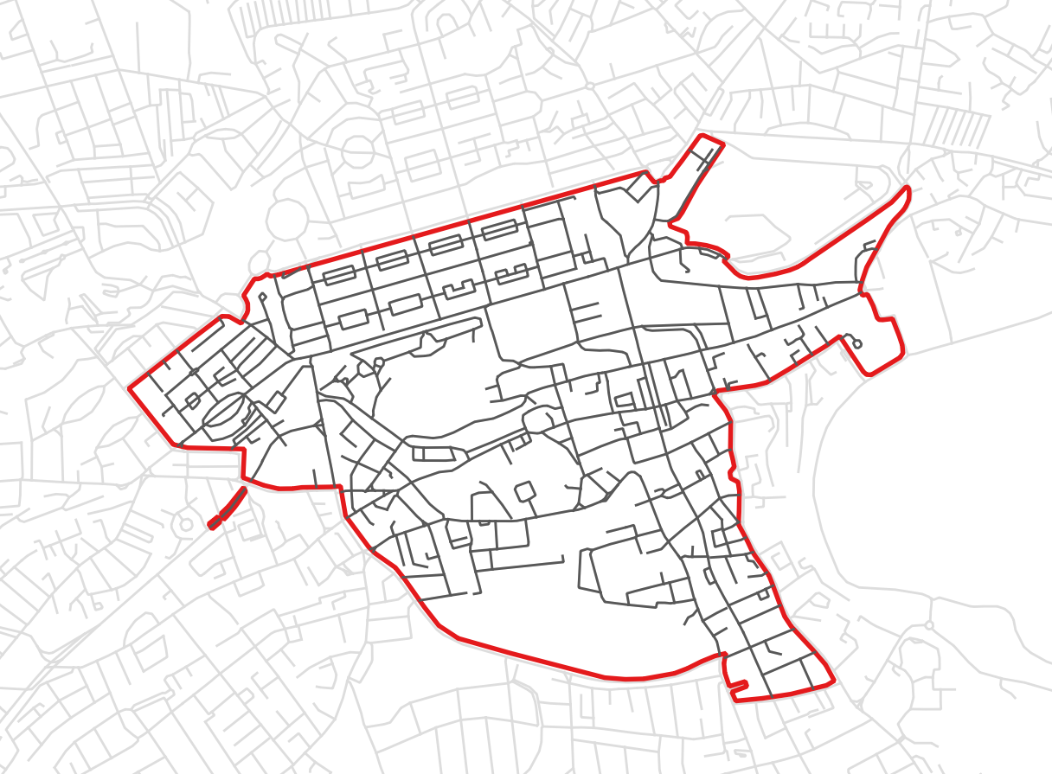
Visualising geo-processed data
For vectors, you could have the original layer as the reference layer.
Then overlay the geo-processed data to highlight analysis in focus.
Let’s change the symbology and ensure layer arrangement is right.

Slide 18
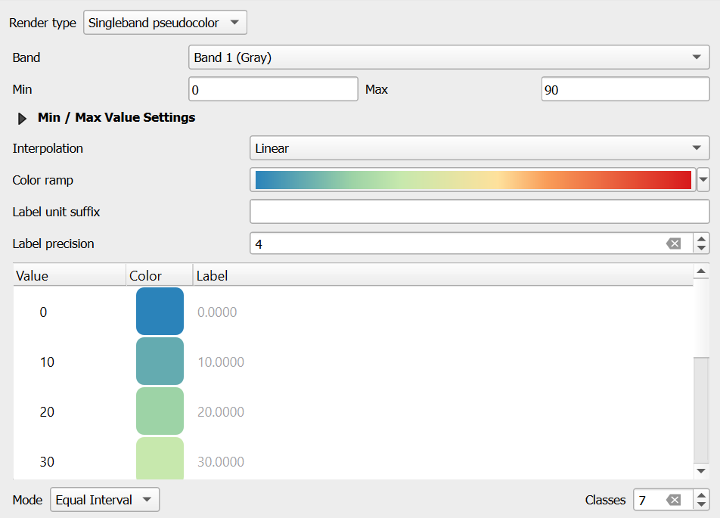
Visualising geo-processed data
For rasters, singleband pseudocolour is always a good one to set data to display at specific intervals.
You can also make use of the pre-set colour ramp, which gives you a good range of symbology for most maps.

Slide 19
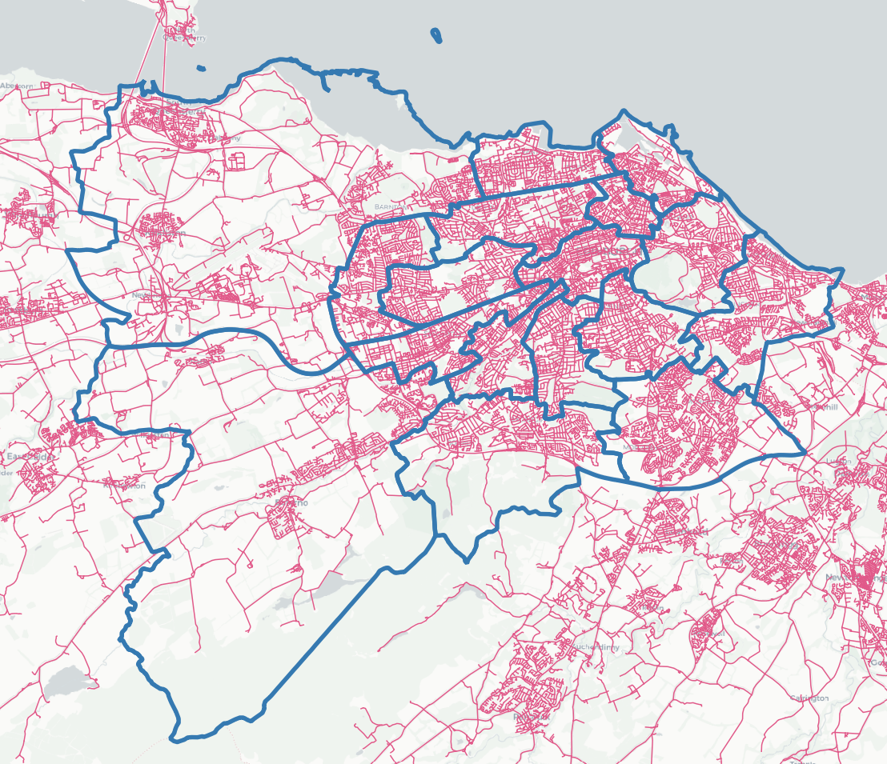
Geoprocessing - Intersection
If I have multiple polygons to clip and if I use the clip tool, information of the ‘clipping polygon’ (i.e. Ward Boundaries) will be missing in the geoprocessed layer. What to do?
In this case, you will need to use “Intersection” instead. Let’s try this now.
Import Edinburgh Ward Boundaries into QGIS.
Go to processing toolbox, look up for the tool and this time, intersect with the ward boundaries of Edinburgh instead.

Slide 20
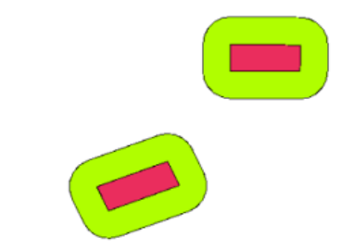
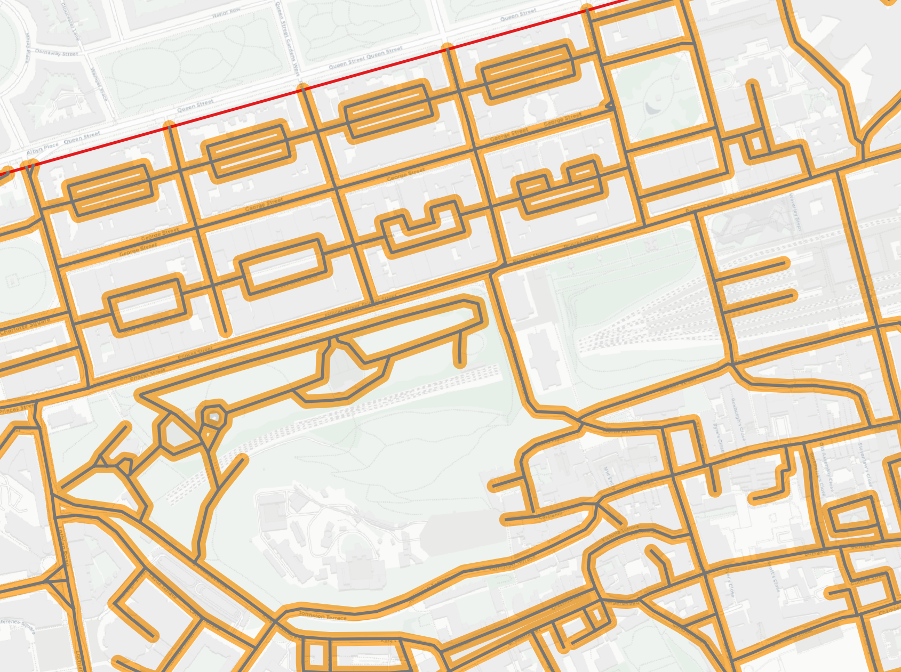
Geoprocessing - Buffer
Draws a polygon at a set distance around a layer (Therefore, vectors only)
Open the Processing Toolbox
Search for buffer
Double-click the tool to open it
Set your input layer (OS_roads)
Set the distance you would like to buffer (10m)
Click Run
For visualisation, good to have buffer underneath the roads and make it semi-transparent to see the base map.

Slide 21

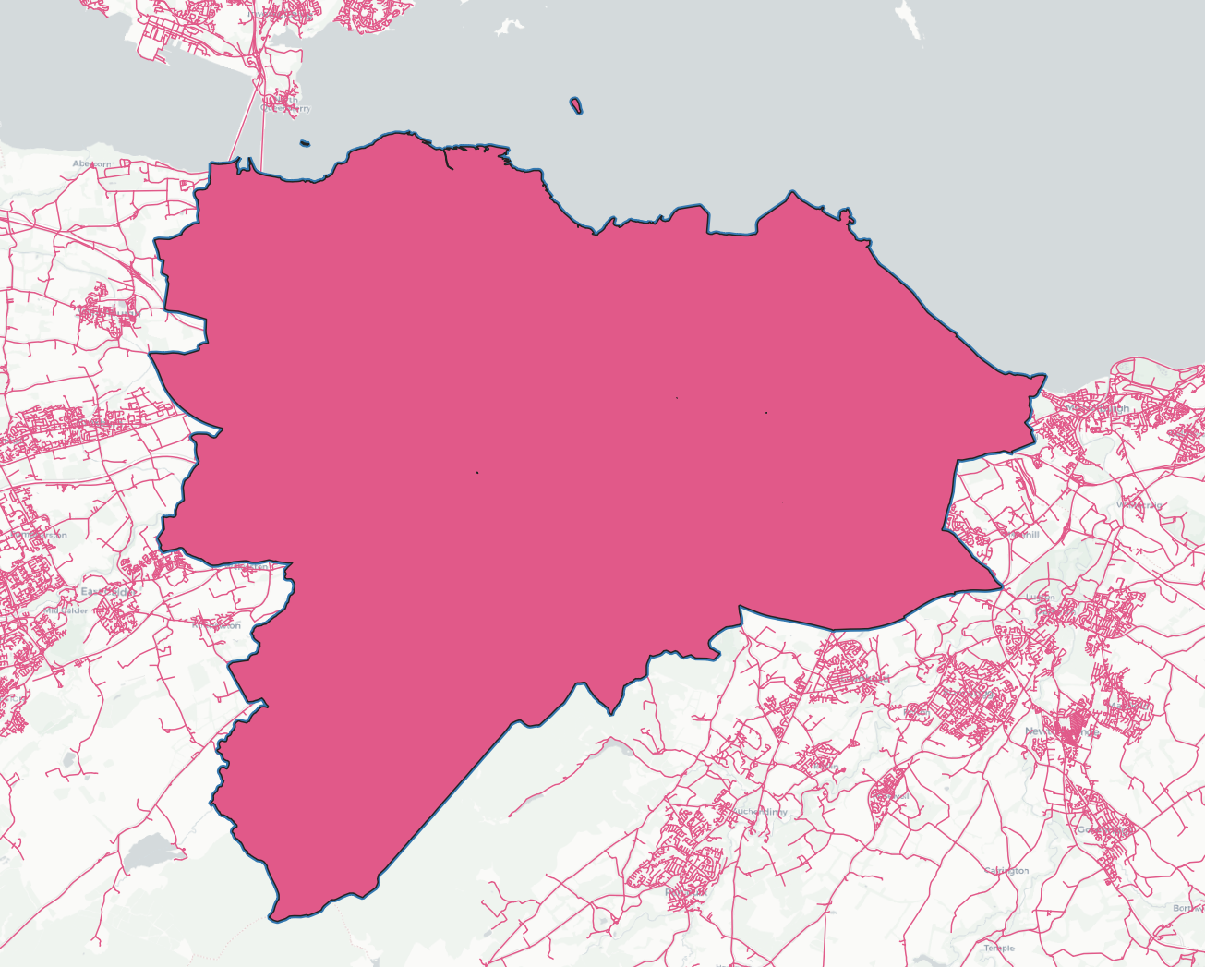
Geoprocessing - Dissolve
How about if I would like to take a look at the density of road network within the whole Edinburgh area?
Again, if you can find the official boundary from the Council, then use it.
Otherwise, you could use the dissolve tool, which merges all the polygons into one.
*Dissolve combines multiple features with the same value into one feature. Data will be lost. Think carefully before performing.

Slide 22
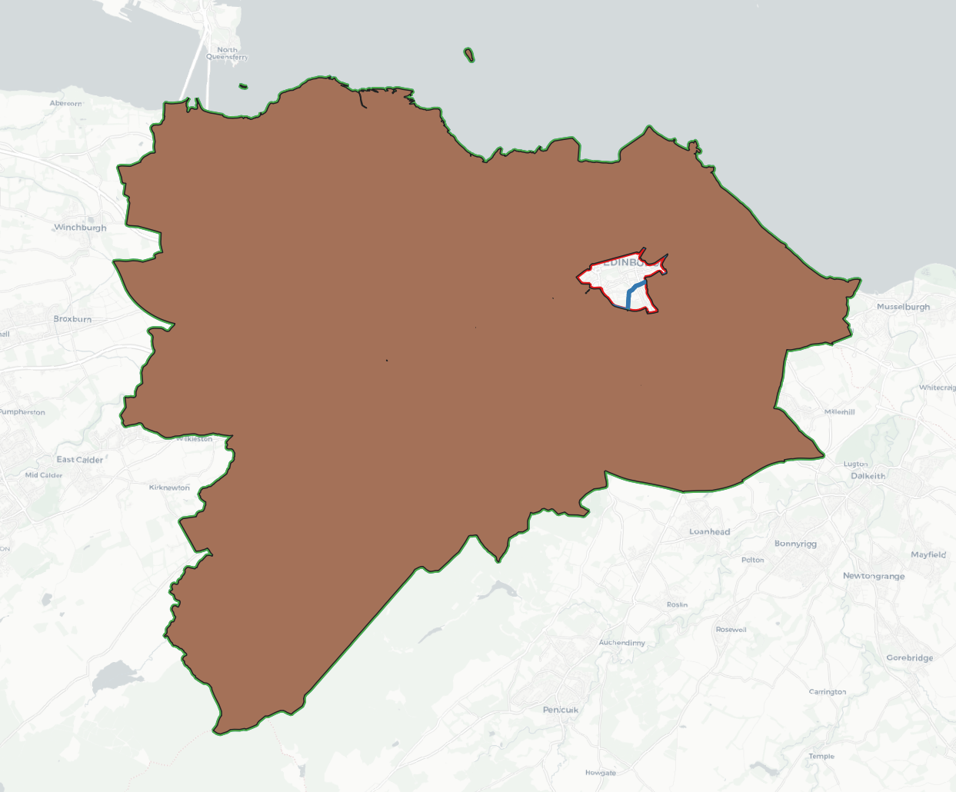
Geoprocessing - Difference
What if, I’m interested in the area between the LEZ and the overall Edinburgh Area (i.e. a hollow within a bigger geometry)
Processing toolbox> Difference

Slide 23
Geoprocessing - point to note
Geospatial analysis, whether descriptive/ inferential, the first step is to get the extent of geography that you are interested and then perform the analysis.
Hence, learning how to use the tools (clip, buffer, intersection, dissolve, difference) are useful.
These tools are only typically performed when two or more vector layers are of the same kind (i.e. polygons & polygons, lines & lines, not polygon & lines).
Raster can only be ‘geo-processed’ with clip by mask layer. The tools above are not applicable to raster files.

Slide 24
Simple geospatial analysis
Mostly descriptive statistics in QGIS (excluding combination with R/ Python).
Let’s master the most common two functions.
Count points in polygon (vector)
Count total lengths in polygon (vector)
Zonal statistics (raster)

Slide 25
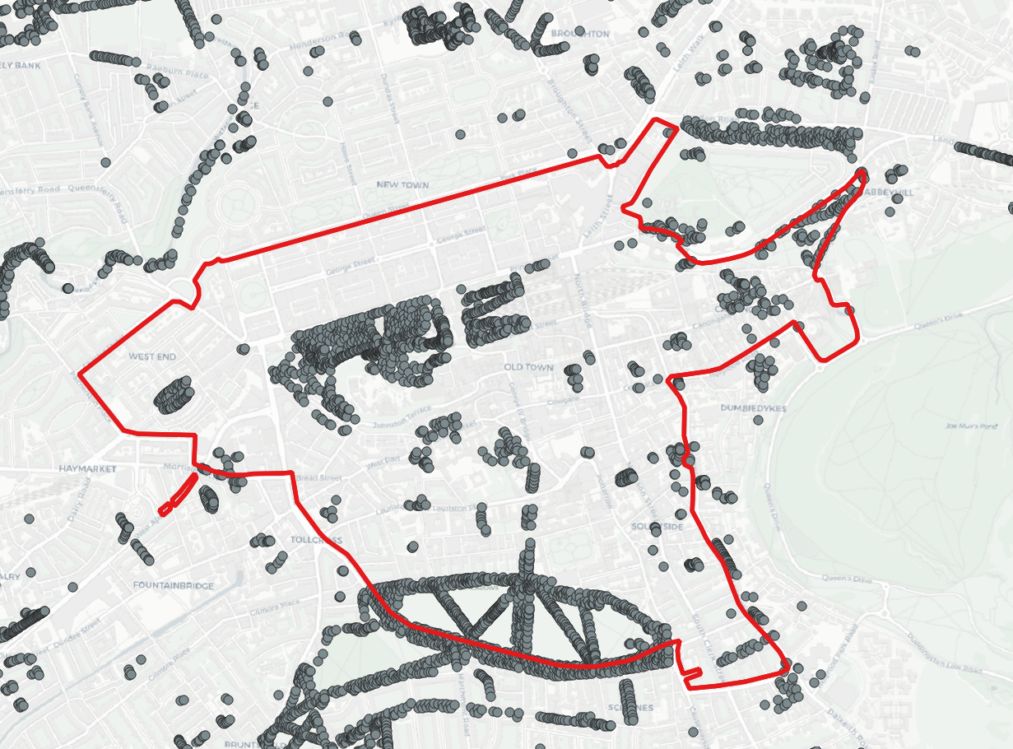
Count points in polygon (vector)
To count the number of points that fall within each polygon in a layer. It takes two input layers: a polygon layer and a point layer.
The tool adds a new attribute field to the polygon layer's attribute table, which contains the count of points for each polygon.
This new field can be used for further analysis or visualisation.
Example applications:
Calculating the number of facilities (e.g., hospitals, schools) within administrative boundaries.
Determining the density of features (e.g., trees, streetlights) in different areas.
Analysing the distribution of events or incidents across regions.

Slide 26
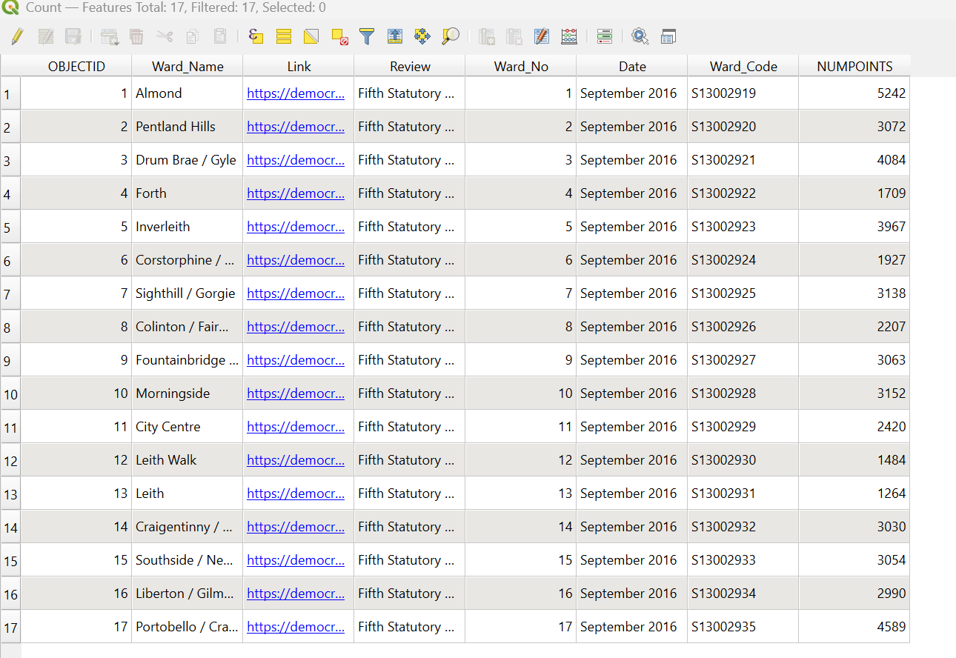
Count points in polygon (vector)
Let’s try this tool with tree information.
Import the tree layer into QGIS
Search ‘count points in polygon’ in processing toolbox.
Let’s see how many trees are there in the Low Emission Zone.
Now, repeat with Edinburgh Wards.

Slide 27
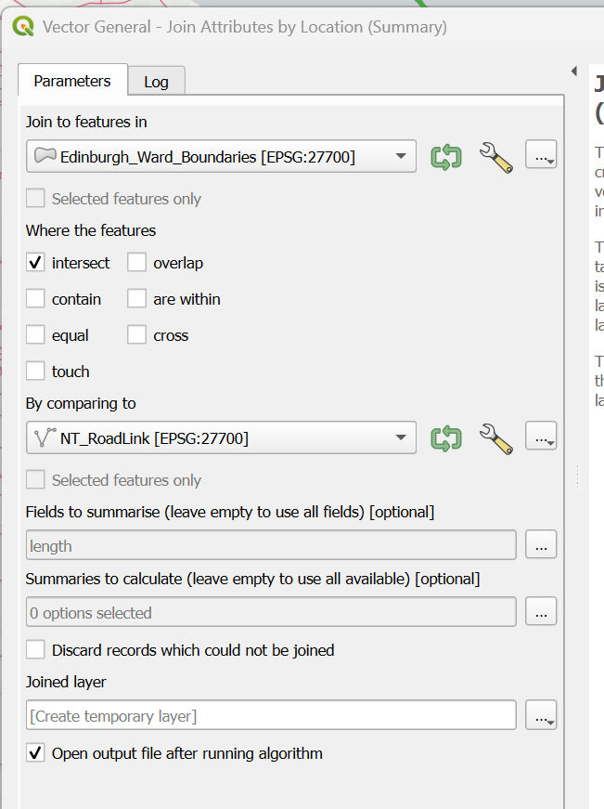
Count total lengths in polygon (vector)
How about lengths then?
Yes! Still a click with “Join attributes by location”
The tool basically summarises a specific attribute of a layer based on another layer.
In this case, we want QGIS to summarise road length (“length” in attribute table) based on Edinburgh Ward Boundaries.
The input information is slightly more tricky as shown on the right.

Slide 28
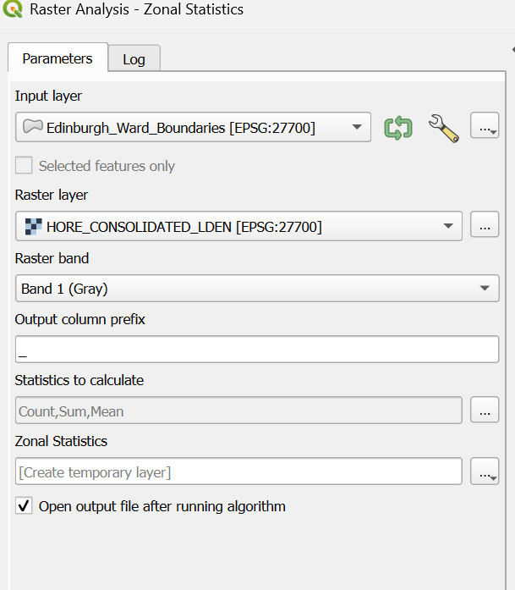
Zonal Statistics
So far, we have learnt to summarise vector info with reference to a polygon, can we do the same with rasters?
Yes, and in fact very common. And it has a different name called Zonal Statistics in processing toolbox.
Use Edinburgh Ward Boundaries as the input layer and then the noise layer as the raster layer.

Slide 29
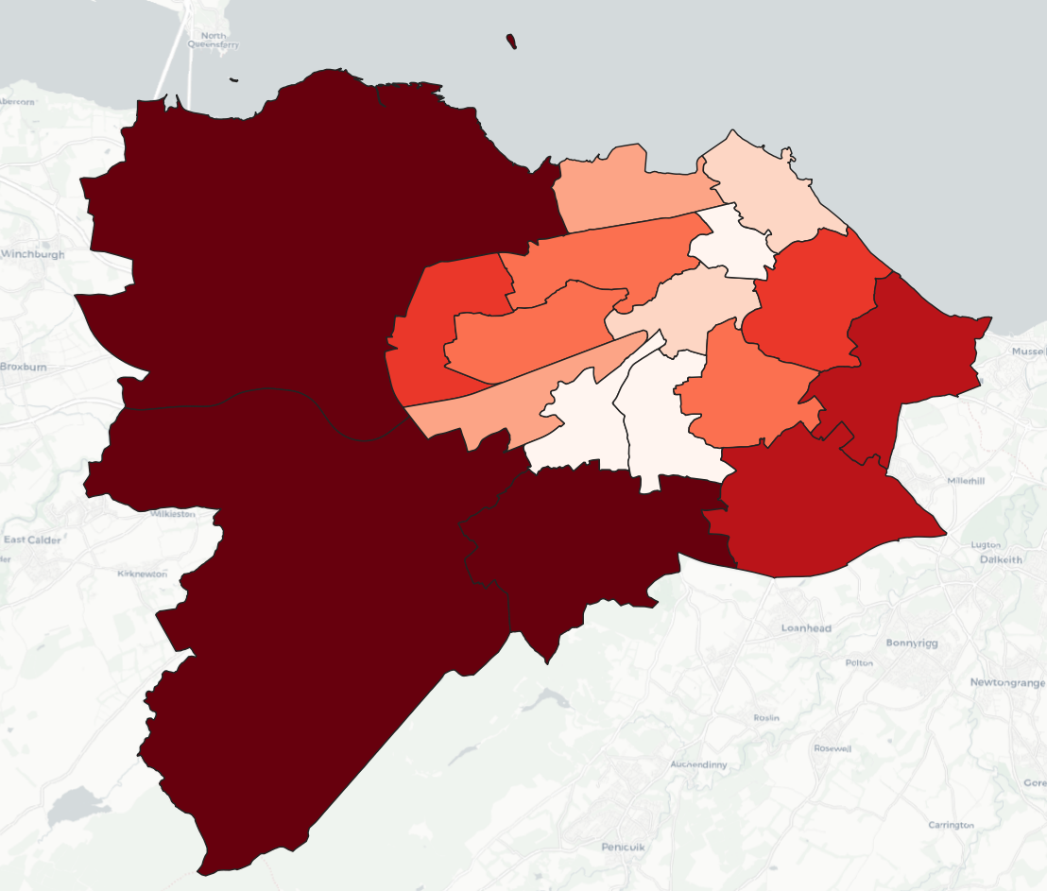
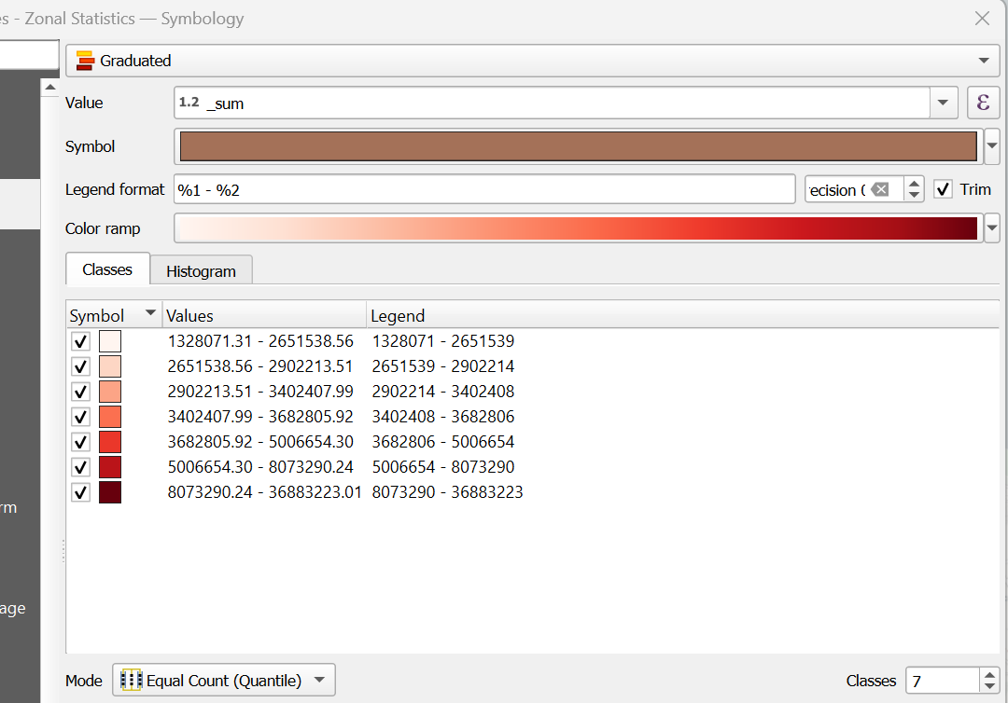
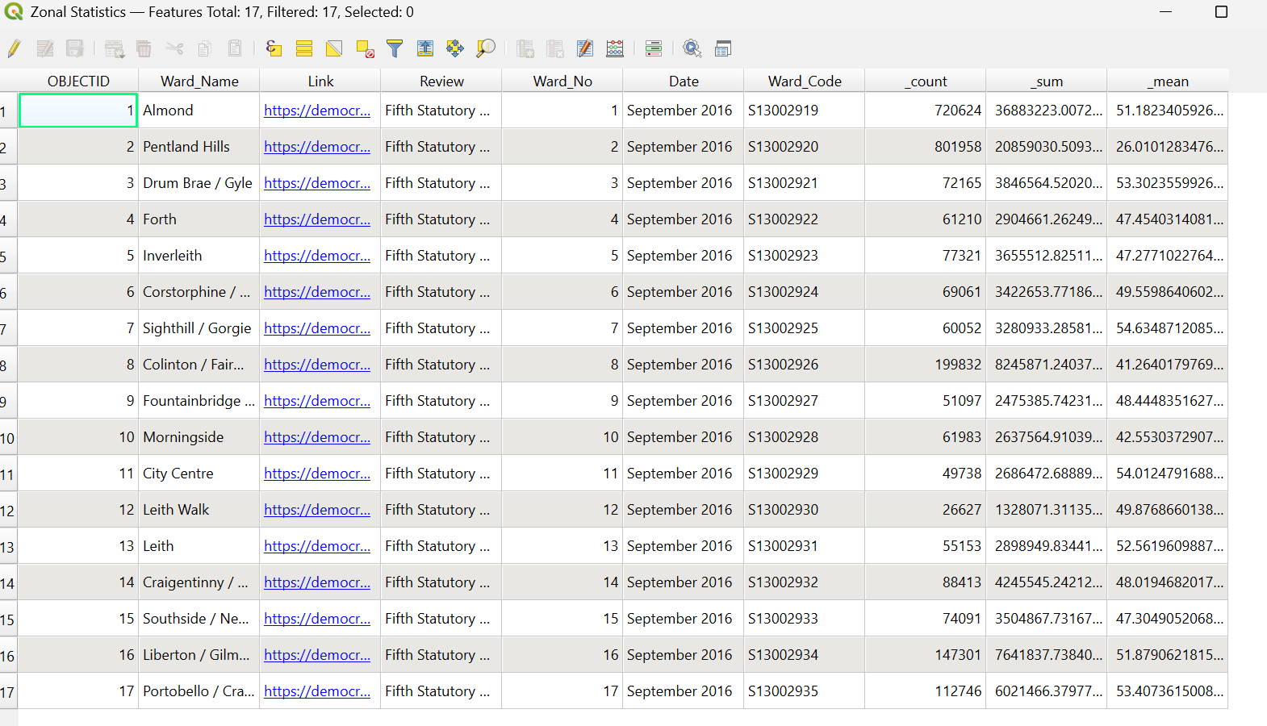
You can also play around with visualising the geo-processed data.

Slide 30
Summary
The first step of any geospatial analysis is to find the right information, followed by organising them right. Therefore, learning how to merge accurately and smartly is key.
The second step is to ensure the extent of analysis is set. Therefore, different geoprocessing tools (clip, intersection, buffer, difference, dissolve) to create polygon boundaries for analysis will be essential.
Simple descriptive statistics (sum based on polygons) are often the first step to have an overview of patterns and trends. Hence, recommend to master and play around with the last few techniques as taught.
Hope it’s useful!

Slide 31
THANK YOU!

Slide 32
BACK UP SLIDES

Slide 33
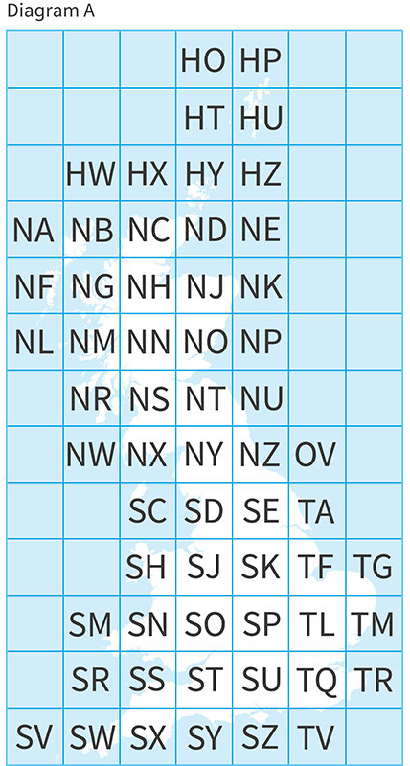
Workflow to organise datasets
Geo datasets are massive! Raw datasets are typically available in “chunks”.
E.g. Topographical data in tiles

Slide 34
Workflow to organise datasets
Common issue:
Area of interest too big (e.g. London needs SP, TL, SU and TQ depending the extent of interest)
Extracting the right tiles are therefore, important.

Slide 35
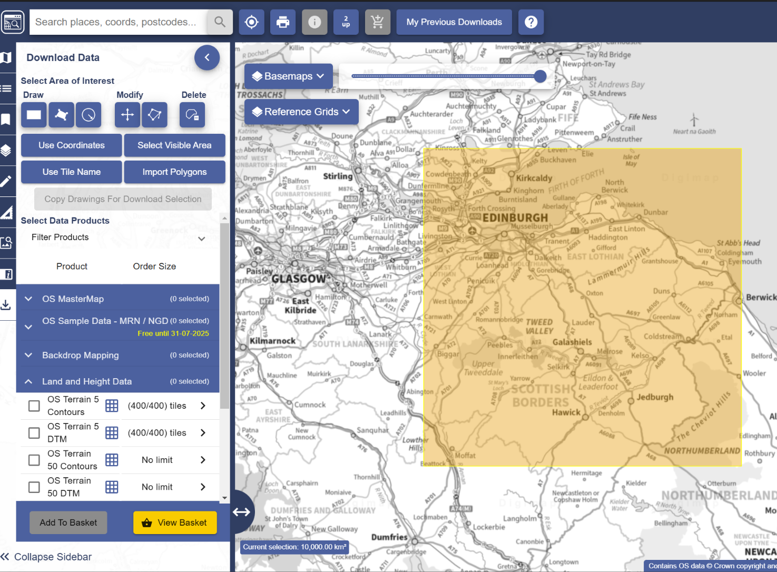
Workflow to organise datasets
Common issue:
Area of interest too big (e.g. London needs SP, TL, SU and TQ depending the extent of interest)
Extracting the right tiles are therefore, important.
Let’s set up today’s session and use topographical data as an example.
Download the extent for Edinburgh, which is NT via digimap.
* if you don’t have a digimap account, you can download both tiles from the class folder.

Slide 36
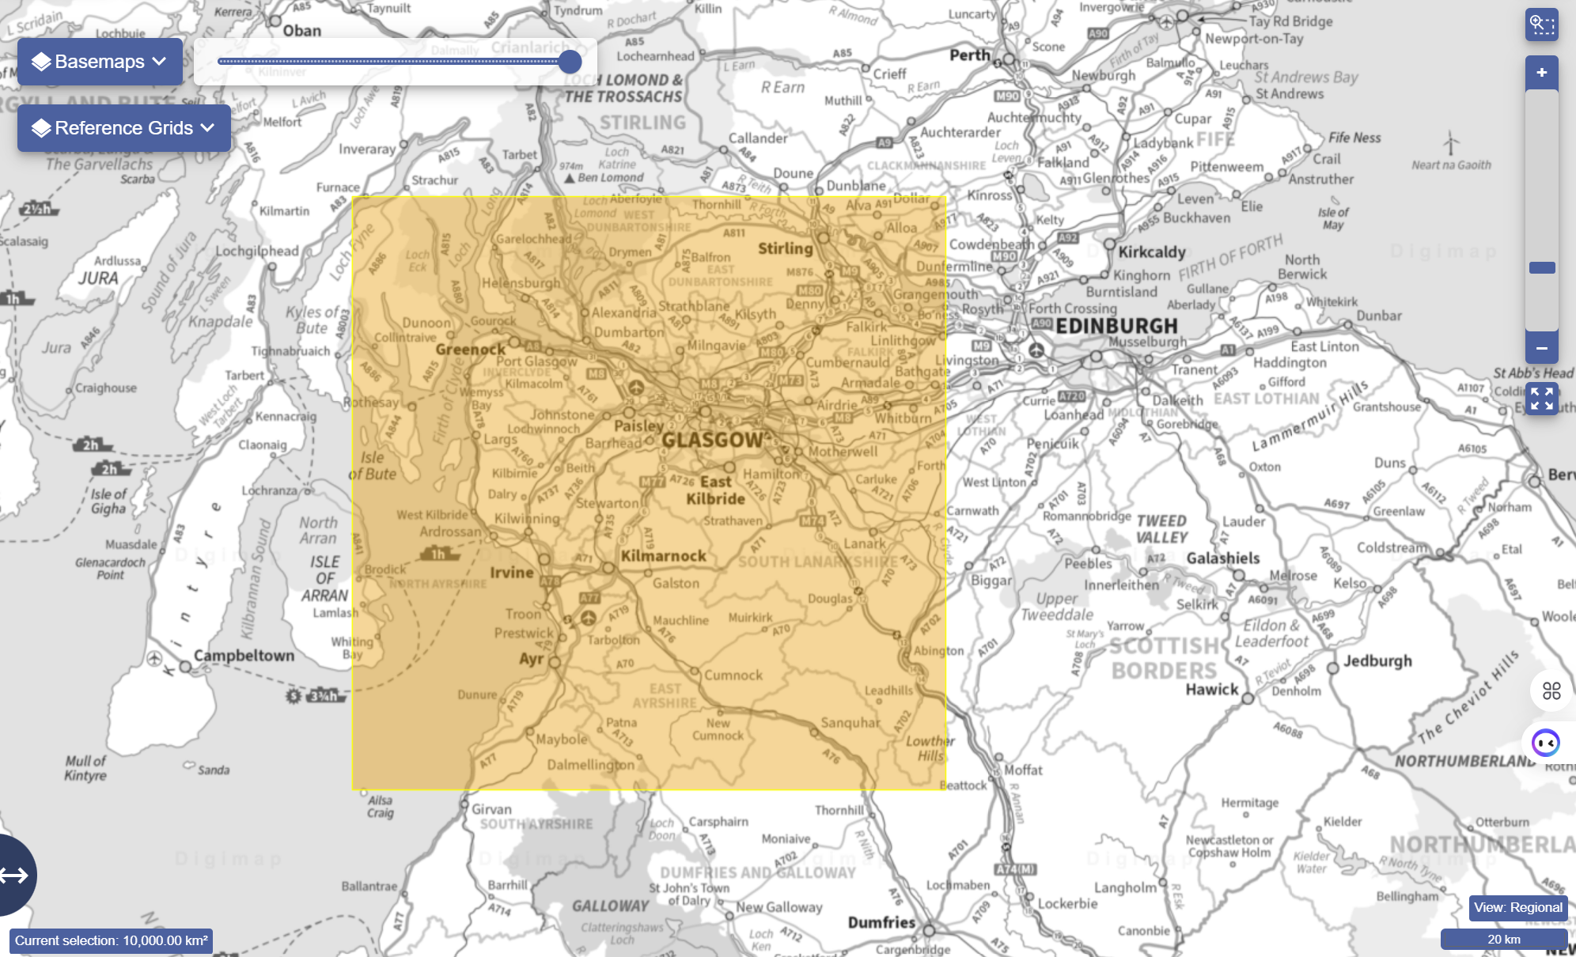
Workflow to organise datasets
Now download NS, which is the tile covering Glasgow.
Import both layers to QGIS.
* if you don’t have a digimap account, you can download both tiles from the class website.

